Slide 1


PYTHON
Lecture 38

Slide 2

Today’s Agenda
Dictionary-III
Dictionary Methods
Removing Elements From Dictionary
Functions Used In Dictionary

Slide 3
Dictionary Methods
Python provides us following methods to work upon dictionary object:
clear()
copy()
setdefault()
get()
items()
keys()
pop()
popitem()
update()
values()

Slide 4

The copy( ) Method
This method returns a shallow copy of the dictionary.
Syntax:
dict.copy()
Example:
original = {1:'one', 2:'two'}
new = original.copy()
print('new: ', new)
print('original: ', original)
Output:

Slide 5
copy( ) v/s =
When copy() method is used, a new dictionary is created which is filled with a copy of the data from the original dictionary.
When = operator is used, a new reference to the original dictionary is created.

Slide 6


Guess The Output ?
original = {1:'one', 2:'two'}
new = original.copy()
new.clear()
print('new: ', new)
print('original: ', original)
original = {1:'one', 2:'two'}
new = original
new.clear()
print('new: ', new)
print('original: ', original)
Output: Output:

Slide 7
The setdefault( ) Method
This method method returns the value of a key (if the key is in dictionary).
If not, it inserts key with a value to the dictionary.
Syntax:
dict.setdefault(key,[value])
The setdefault() takes maximum of two parameters:
key - key to be searched in the dictionary
default_value (optional) - key with a value default_value is inserted to the dictionary if key is not in the dictionary. If not provided, the default_value will be None.
The setdefault() returns:
value of the key if it is in the dictionary
None if key is not in the dictionary and default_value is not specified
default_value if key is not in the dictionary and default_value is specified

Slide 8
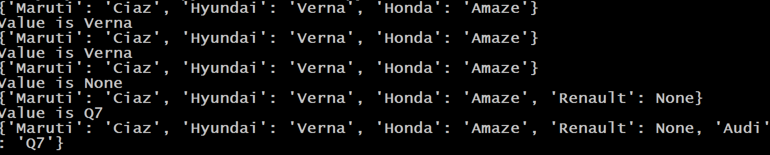
Guess The Output ?
cars = {"Maruti":"Ciaz","Hyundai":"Verna","Honda":"Amaze"}
print(cars)
value=cars.setdefault("Hyundai")
print("Value is",value)
print(cars)
value=cars.setdefault("Hyundai","i10")
print("Value is",value)
print(cars)
value=cars.setdefault("Renault")
print("Value is",value)
print(cars)
value=cars.setdefault("Audi","Q7")
print("Value is",value)
print(cars)
Output:

Slide 9
Using in And not in With Dictionary
We can apply the ‘in’ and ‘not in’ operators on a dictionary to check whether it contains a certain key.
If the key is present then in returns True ,otherwise it returns False.
Similarly , if the key is not present not in returns True , otherwise it returns False

Slide 10
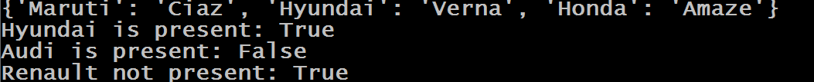
Guess The Output ?
cars = {"Maruti":"Ciaz","Hyundai":"Verna","Honda":"Amaze"}
print(cars)
print("Hyundai is present:","Hyundai" in cars)
print("Audi is present:" ,"Audi" in cars)
print("Renault not present:","Renault" not in cars)
Output:

Slide 11
Dictionary Comprehension
Just like we have list comprehension , we also have dictionary comprehension
Dictionary Comprehension is a mechanism for transforming one dictionary into another dictionary.
During this transformation, items within the original dictionary can be conditionally included in the new dictionary and each item can be transformed as needed.

Slide 12
Syntax For Dictionary Comprehension
Syntax:
dict_variable = { key:value for (key,value) in iterable}
Explanation
Iterable can be any object on which iteration is possible
(key,value) is the tuple which will receive these key-value pairs one at a time
key:value is the expression or key-value pair which will be assigned to new dictionary

Slide 13
Exercise
Write a program to produce a copy of the dictionary cars using dictionary comprehension
cars = {"Maruti":"Ciaz","Hyundai":"Verna","Honda":"Amaze"}
newcars={ k:v for (k,v) in cars.items()}
print(newcars)
Output:

Slide 14
Exercise
How will you do the same without dictionary comprehension or copy( ) method ?
cars = {"Maruti":"Ciaz","Hyundai":"Verna","Honda":"Amaze"}
newcars={}
for (k,v) in cars.items():
newcars[k]=v
Output:

Slide 15
Exercise
Write a program to produce a new dictionary from the given dictionary with the values of each key getting doubled
dict1 = {'a': 1, 'b': 2, 'c': 3, 'd': 4, 'e': 5}
double_dict1 = {k:v*2 for (k,v) in dict1.items()}
print(double_dict1)
Output:

Slide 16
Exercise
Write a program to produce a new dictionary from the given dictionary with the keys of each key getting doubled
dict1 = {'a': 1, 'b': 2, 'c': 3, 'd': 4, 'e': 5}
double_dict1 = {k*2:v for (k,v) in dict1.items()}
print(double_dict1)
Output:

Slide 17
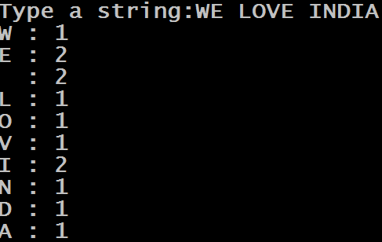
Exercise
Write a program to accept a string from the user and print the frequency count of it’s letters , i.e. how many times each letter is occuring in the string
Output:

Slide 18
Solution
str=input("Type a string:")
mydict={ch:str.count(ch) for ch in str}
for k,v in mydict.items():
print(k,":",v)

Slide 19
Adding Conditions To Dictionary Comprehension
Like list comprehension , dictionary comprehension also allows us to add conditionals to make it more powerful.
Syntax:
dict_variable = { key:value for (key,value) in iterable <test_cond>}
As usual , only those key-value pairs will be returned by dictionary comprehension which satisfy the condition

Slide 20
Exercise
Write a program to produce a new dictionary from the given dictionary but with the values that are greater than 2 and store their doubles
dict1 = {'a': 1, 'b': 2, 'c': 3, 'd': 4, 'e': 5}
dict2 = {k:v*2 for (k,v) in dict1.items() if v>2}
print(dict2)
Output:

Slide 21

Exercise
Write a program to produce a new dictionary from the given dictionary but with the double of the values that are greater than 2 as well as multiple of 2
dict1 = {'a': 1, 'b': 2, 'c': 3, 'd': 4, 'e': 5}
dict2 = {k:v*2 for (k,v) in dict1.items() if v>2 if v%2==0}
print(dict2)
Output:

Slide 22
Exercise
Write a program to produce a new dictionary from the given dictionary but the value should be the string “EVEN” for even values and “ODD” for odd values
dict1 = {'a': 1, 'b': 2, 'c': 3, 'd': 4, 'e': 5}
dict2= {k:'even' if v%2==0 else 'odd' for (k,v) in dict1.items()}
print(dict2)
Output:

Slide 23
Restrictions On Dictionary Keys
Almost any type of value can be used as a dictionary key in Python , like integer, float, Boolean etc
Example:
d={65:"A", 3.14:"pi", True:1}
print(d)
Output:

Slide 24
Restrictions On Dictionary Keys
We can even use built-in objects like types and functions:
Example:
d={int:1, float:2, bool:3}
print(d)
print(d[float])
Output:

Slide 25
Restrictions On Dictionary Keys
Duplicate keys are not allowed. If we assign a value to an already existing dictionary key, it does not add the key a second time, but replaces the existing value:
Example:
d={"MP":"Indore","UP":"Lucknow","RAJ":"Jaipur"}
print(d)
d["MP"]="Bhopal"
print(d)
Output:

Slide 26
Restrictions On Dictionary Keys
If we specify a key a second time during the initial creation of a dictionary, the second occurrence will override the first:
Example:
d={"MP":"Indore","UP":"Lucknow","RAJ":"Jaipur","MP":"Bhopal"}
print(d)
Output:

Slide 27
Restrictions On Dictionary Keys
A dictionary key must be of a type that is immutable. Like integer, float, string and Boolean—can serve as dictionary keys. Even a tuple can also be a dictionary key, because tuples are immutable:
Example:
d = {(1, 1): 'a', (1, 2): 'b', (2, 1): 'c', (2, 2): 'd'}
print(d)
print(d[(1,2)])
Output:

Slide 28
Restrictions On Dictionary Keys
However, neither a list nor another dictionary can serve as a dictionary key, because lists and dictionaries are mutable:
Example:
d = {[1, 1]: 'a', [1, 2]: 'b', [2, 1]: 'c', [2, 2]: 'd'}
print(d)
Output:

Slide 29
Restrictions On Dictionary Values
There are no restrictions on dictionary values.
A dictionary value can be any type of object Python supports, including mutable types like lists and dictionaries, and user-defined objects
There is also no restriction against a particular value appearing in a dictionary multiple times:

Slide 30
Exercise
Write a complete COUNTRY MANAGEMENT APP. Your code should store COUNTRY CODE and COUNTRY NAME as key-value pair in a dictionary and allow perform following operations on the dictionary :
View
Add
Delete
To start the program initialize your dictionary with
the following set of key-value pairs:
IN→India
US→America
AU→Australia
CA→Canada

Slide 31
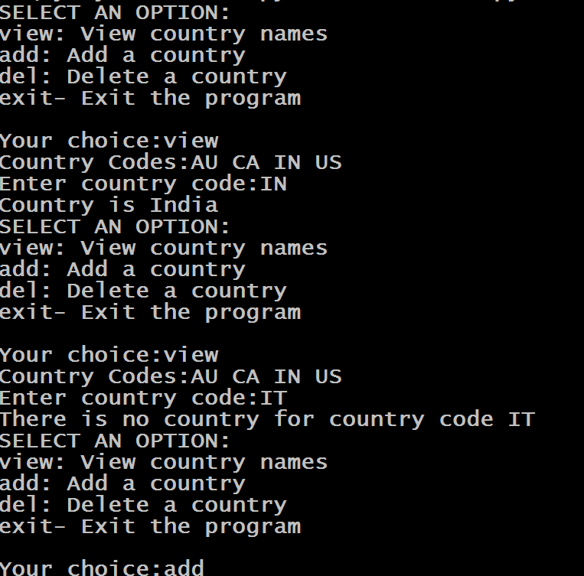
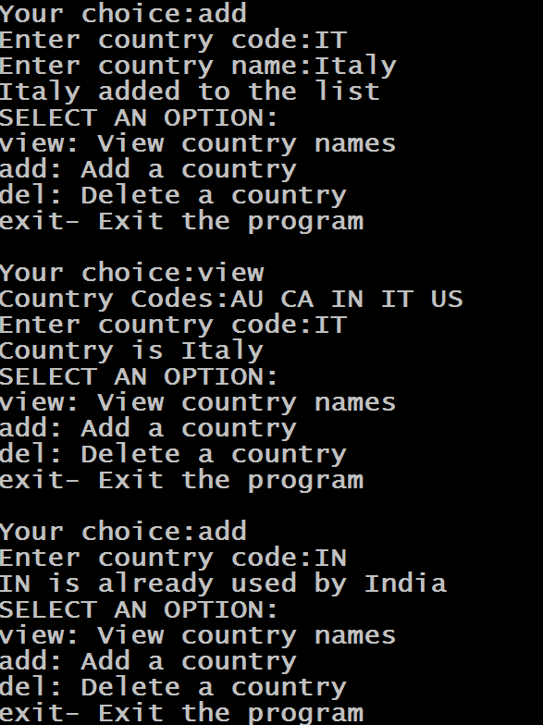
Sample Output

Slide 32
Solution
def show_menu():
print("SELECT AN OPTION:")
print("view: View country names")
print("add: Add a country")
print("del: Delete a country")
print("exit- Exit the program")
print()
def show_codes(countries):
codes=list(countries.keys())
codes.sort()
str="Country Codes:"
for x in codes:
str+=x+" "
print(str)

Slide 33
Solution
def view_country(countries):
show_codes(countries)
code=input("Enter country code:")
cname=countries.get(code.upper())
if cname==None:
print("There is no country for country code",code)
else:
print("Country is",cname)
def add_country(countries):
code=input("Enter country code:")
code=code.upper()
cname=countries.get(code)
if cname==None:
cname=input("Enter country name:")
cname=cname.title()
countries[code]=cname
print(cname, "added to the list")
else:
print(code ,"is already used by",cname)

Slide 34
Solution
def del_country(countries):
code=input("Enter country code:")
cname=countries.pop(code.upper(),"NF")
if cname=="NF":
print("Sorry! You entered a wrong country code")
else:
print(cname ,"was deleted successfully! from the list")
countries={"IN":"India","US":"America","AU":"Australia","CA":"Canada"}
while True:
show_menu()
choice=input("Your choice:")
if choice=="view":
view_country(countries)
elif choice=="add":
add_country(countries)
elif choice=="del":
del_country(countries)
elif choice=="exit":
break;
else:
print("Wrong choice ! Try again!")

Slide 35
Exercise
Modify the previous code , so that now you are able to store 3 values for each key . These are COUNTRY NAME , CAPITAL CITY and POPULATION. Provide same options to the user and start with the following data
IN→India , Delhi,1320000000
US→America,Washington,320000000
AU→Australia,Canberra,24000000
CA→Canada,Ottawa,940000

Slide 36
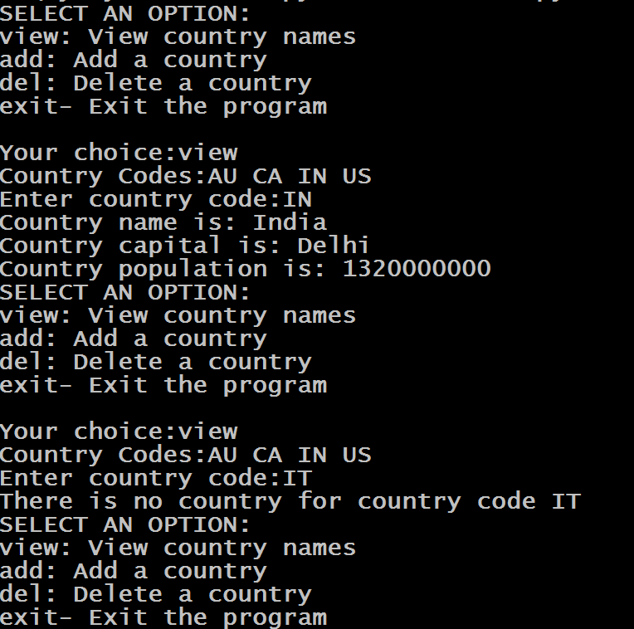
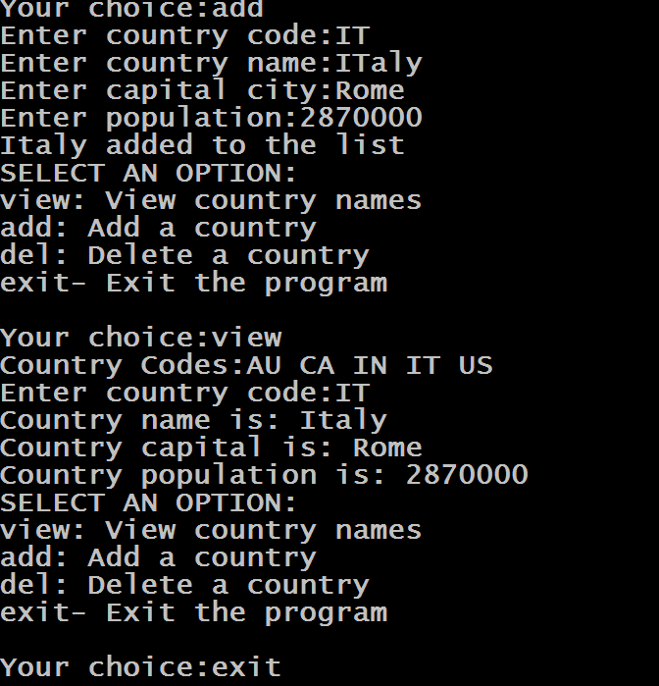
Sample Output

